Slide 1
Ontario District Windsor Essex Great Lakes District Event (WEGLDE)
St. Denis Center - University of Windsor
April 2, 2022
This information can also be found: https://www.firstroboticscanada.org/frc/windsorfrc/

Slide 2
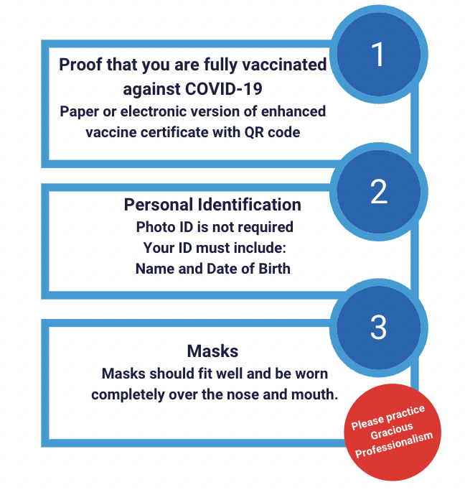
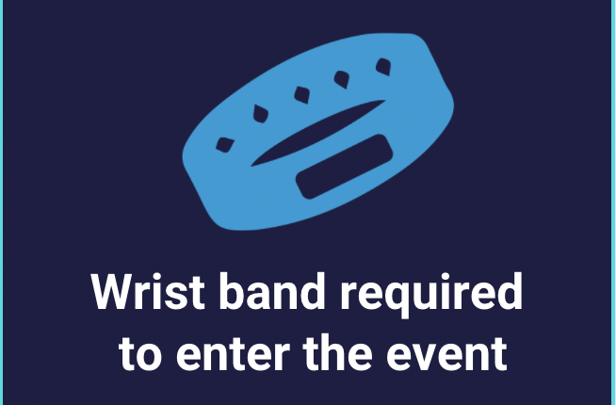
2022 Windsor Essex Great Lakes Event - Safety
Notes:
Karthik

Slide 3
2022 Windsor Essex Great Lakes Event
https://www.firstroboticscanada.org/frc/windsorfrc/
Prior to the Event
Capacity - Team Roster & Attendance
Judging Schedule
Virtual Drivers Meeting
Match Schedule
At the Event
Registration and Load In
Practice Field and Machine Shop
Team Lunches, Quiet Room

Slide 4
2022 University of Windsor Team capacity
Capacity Limit: 25 team members
Roster and Team Attendance
Wristband entry for Load In and Event Days
Entrances and Process
Address: St. Denis Center 2555 College Ave, Windsor, ON N9B 3P4
Parking
See map on next slide for lots that are sponsored by Windsor Essex FIRST Robotcs- (cars and pick up trucks only - no large trucks no trailers!!);
Parking for trailers and buses available at the Catholic School Board Lot beside the St. Denis Center off Huron Church Rd.
All other lots are PAY & DISPLAY !
Entry Points:
For Load-In line up & you will be told when to get out of vehicles to check in and receive bracelet - see map on next slide
For Event Day use main St. Denis Center Doors
Notes:
Arti

Slide 5
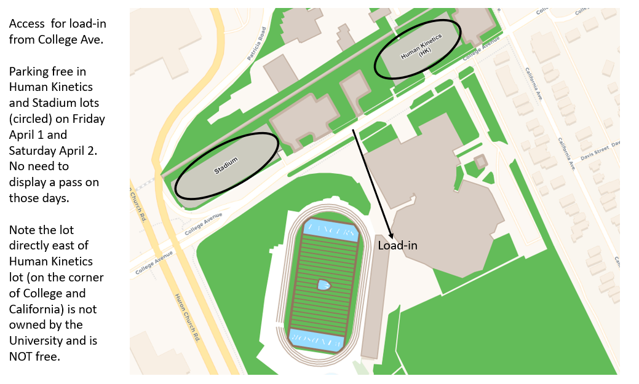
Notes:
2555 College Ave, Windsor, ON N9B 3P4
Teams will load in on a First Come First Serve basis. Teams can line up on College Ave, look for the Load-In Flags on the west side of the building. Please stay in your vehicles until a volunteer comes to tell you that your five people can come to the loading door to check in. After the five people for load-in are checked in, return to your vehicle to wait to move up to the door. Teams will load in two at a time, when unloaded drivers can go to the end and take the turn around and head back out. Each team MUST bring maximum 5 team representatives (1 must be an adult) to off load your trailer/car and take items to PIT.
Pack for quick load/unload – large bins/NO loose items, bring dollies to help you transport your load
Team helpers (if not in truck), must arrive before truck arrives or load in may not happen
CHECK IN near the load in doors when told to do so. Please do not go to the main St. Denis Centre doors for check in on Friday night.
Teams will have 1 hour time from Load In time to set up your pits.
Please see the attached map for load in location and parking.
Please use patience as we move through the process and support all teams.

Slide 6
2022 Windsor Essex Great Lakes Judging and Awards
All Judging is being done remotely
Pit Interviews are scheduled for
Monday - March 28
Wednesday - March 30
Chairman’s Teams Interviews took place
February 28 - March 3
Dean’s List Interviews took place
February 21 - February 27
Notes:
Arti

Slide 7
Virtual Drivers Meeting & Inspections
Virtual Drivers Meeting on
Thursday, March 31 @ 7:00 pm ET
Email will be sent to the teams to submit questions for the
FTA, Head Referee, Lead Robot Inspector
Remember to complete your robot inspections prior to the event https://firstfrc.blob.core.windows.net/frc2022/Manual/2022-inspection-checklist.pdf
Bring your form with you, and on load-in you can get your robot inspected.
Notes:
Dave

Slide 8
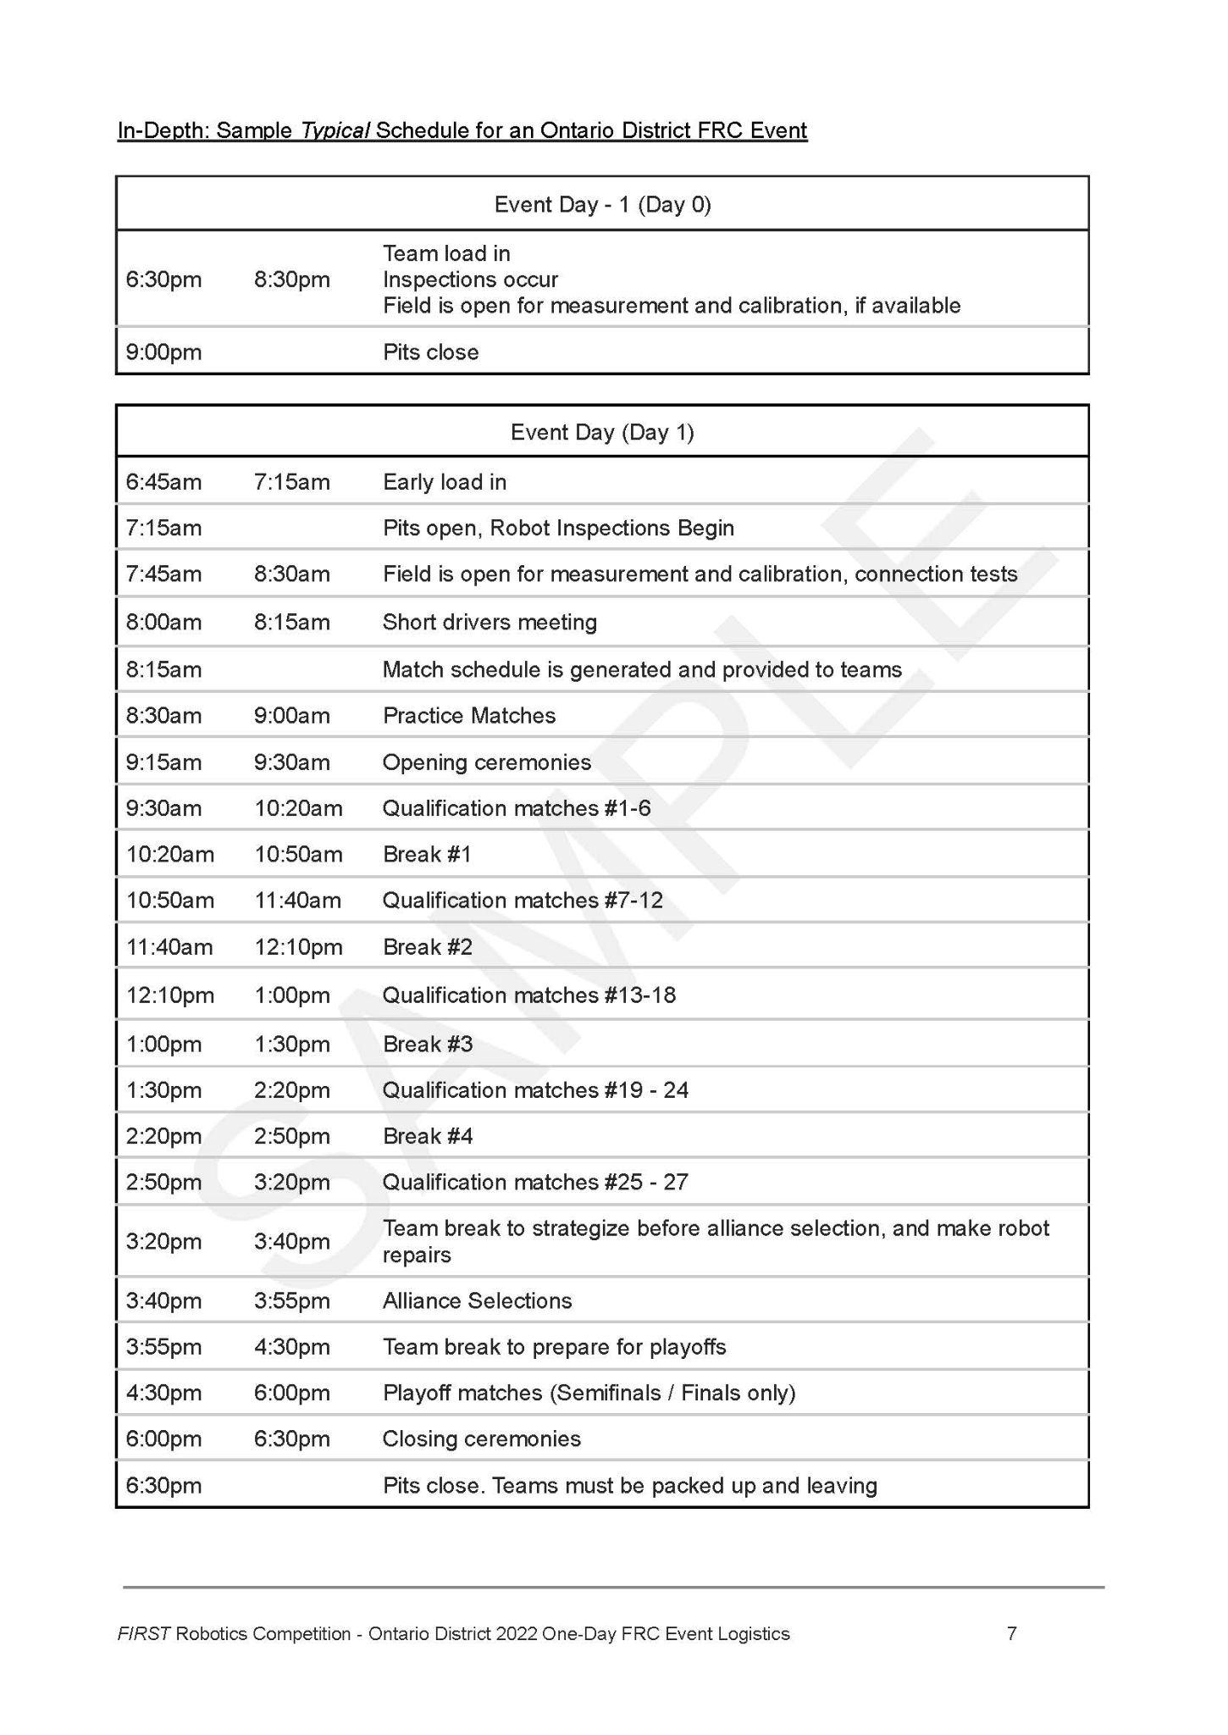
Match Schedule Sample
https://firstfrc.blob.core.windows.net/frc2022/Manual/2022FRCGameManual.pdf

Slide 9
Alliance Selection - 1 Day Events
FRC Field
1
3
5
18
6
17
7
16
8
15
9
14
10
13
11
12
2
4
https://firstfrc.blob.core.windows.net/frc2022/Manual/2022FRCGameManual.pdf
LEGEND
=
Emcee
=
Team Rankings
#’s
=
Teams

Slide 10
Registration and Load-In
To help speed up registration
Have your QR code and ID ready
YOU SHOULD BE ON TEAM ATTENDANCE LIST AND ON TEAM ROSTER
FOR LOAD IN:
Registration and Screening: Loan in doors only when asked to come in, please stay in your vehicle until told to enter, if you have extra people in another vehicle they can wait near your vehicle until time to registter
This is where you will be screened and get your wrist bands for load-in
5 members in total only for load in (1 must be an adult)
COMPETITION DAY (all members)
All members check in for screening and registration: Main doors of the St. Denis Center.
Lot W
Notes:
Arti

Slide 11
Robot Field and Machine Shop
Practice Field Timings
Saturday
7:00 am - 5:00 pm
Machine Shop Timing:
Saturday
7:15 am - 6:00 pm

Slide 12
2022 Windsor Essex Great Lakes Event Reminder Overall Schedule
Monday, March 28 PIT Interviews
Tuesday, March 29
Watch FIRST Canada LIVE! for York and Waterloo District Events
Wednesday, March 30 Pit Interviews
Thursday, March 31 Virtual Drivers Meeting
Tuesday, April 5
Watch FIRST Canada LIVE!
Friday, April 1 Load In for Teams 6:30 - 8:30
Saturday, April 2
Competition Day Load in for Saturday teams (6:45 am-7:30 am) Pit close and Load Out (6:30 pm)

Slide 13
Team Spaces
Designated Team Lunch Area: Picnic tables set up in venue curtained off on far side of field. Please look for your table labeled by your team, and please wipe tables with Lysol Wipes provided after use.
Quiet Room & Prayer Rooms available in Change Room hall.
Reminders!
No eating in pits/competition areas
No buffet/warmers/crock pots in team eating spaces or anywhere in venue
Please respect the space
Demonstrate our Gracious Professionalism to our host venue
Join the Ontario Team Support Slack group!

Slide 14
WEGLDE - Pre Order Lunches
This year at WEGLDE, teams can pre-order individual snacks and sandwiches and/or whole pizzas for lunch on Saturday April 2nd.
Prices on form include taxes.
Form was emailed in Communication #2, March 23, 2022.
Please submit one order per team via email to
Michelle Bondy at mbondy@uwindsor.ca
by Monday, March 28, 2022, at 5pm.

Slide 15
Reminder!
Team Attendance, Roster and Consent Form
IMPORTANT ACTION DUE: March 23, 2022 March 25, 2022
Please remember to assign up to a maximum of 25 attendees (including all students, teachers, mentors, and anyone else affiliated with the team) from your team who will be attending the event. Here is what we need from you
Please complete the Spreadsheet Template here
Complete the Team Roster on the FIRST Inspires Dashboard and download the team roster
Please upload the above 2 documents here (excel template listing team members attending the event + team roster)

Slide 16
Teams Check out the Social Media Contest

Slide 17
Livestream!!

Slide 18
Thank you!
Looking forward to seeing you in Windsor!
Windsor Essex Great Lakes District Event
April 2, 2022
Good Luck Teams!

