Slide 1
Ontario District University of Waterloo Event
March 25 - March 26, 2022
This information can also be found: https://www.firstroboticscanada.org/frc/waterloofrc/agenda/

Slide 2
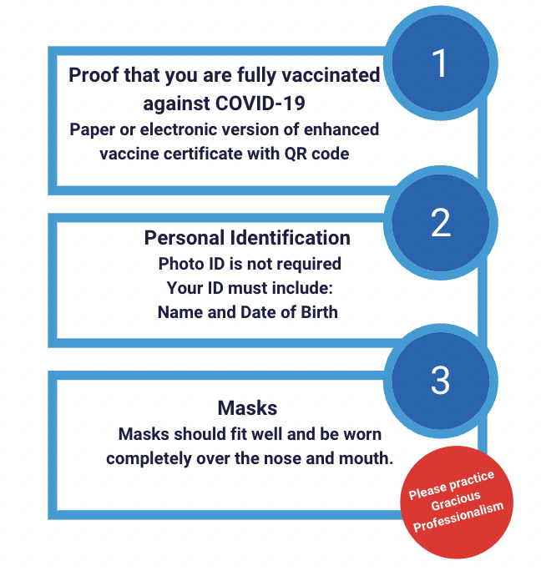
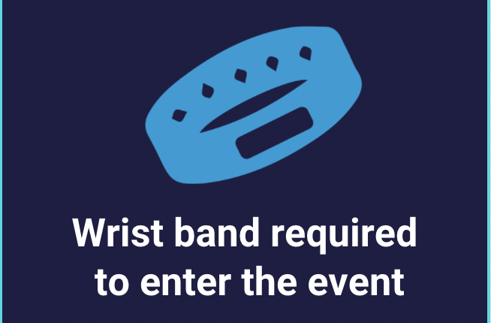
2022 University of Waterloo Event - Safety
Notes:
Karthik

Slide 3
2022 University of Waterloo Event
https://www.firstroboticscanada.org/frc/waterloofrc/
Prior to the Event
Capacity - Team Roster & Attendance
Judging Schedule
Virtual Drivers Meeting
Match Schedule
At the Event
Registration and Load In
Practice Field and Machine Shop
Team Lunches, Quiet Room

Slide 4
2022 University of Waterloo Team capacity
Capacity Limit: 25 team members
Roster and Team Attendance
Wristband entry for Load In and Event Days
Entrances and Process
Address: Physical Activities Complex (PAC), 200 University Avenue W., Waterloo
Parking
Lots M and N - paid - (cars only - no trucks nor trailers!!);
Lots Z and W for cars, trucks and trailers - free of charge
Park correctly to avoid a ticket!
Entry Points:
PAC Box Office Doors
Robot Load-in: PAC Doors close to Ring Road
Notes:
Arti

Slide 5
2022 University of Waterloo Judging and Awards
All Judging is being done remotely
Pit Interviews are scheduled for
Monday - March 21 (25 mins)
Tuesday- March 22 (~10-15 mins)
Awards will be done remotely on March 29
Tune into twitch.tv/FIRSTCanada
Notes:
Arti

Slide 6
Virtual Drivers Meeting & Inspections
Virtual Drivers Meeting on
Wednesday, March 23 @ 6:00 pm ET
Email will be sent to the teams to teams to submit questions for the
FTA, Head Referee, Lead Robot Inspector
Remember to complete your robot inspections prior to the event https://firstfrc.blob.core.windows.net/frc2022/Manual/2022-inspection-checklist.pdf
Notes:
Dave

Slide 7
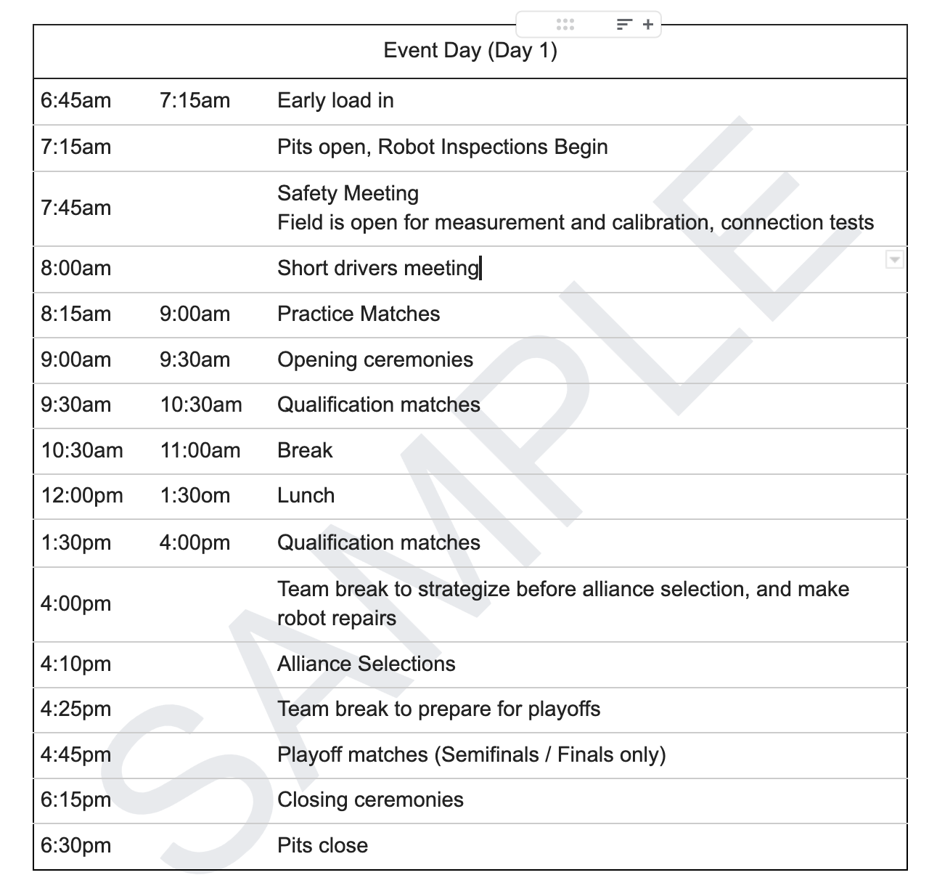
Match Schedule Sample
https://firstfrc.blob.core.windows.net/frc2022/Manual/2022FRCGameManual.pdf

Slide 8
Lunch Schedule
Day 1
Lunch A 12:00 pm | Lunch B 12:30 pm | Lunch C 1:00 pm
771 | 4903 | 4678
8729 | 4069 | 2386
610 | 3683 | 6323
1325 | 7520 | 5024
8789 | 4476 | 8089
6162 | 6331 | 2609
Day 2
Lunch A 12:00 pm | Lunch B 12:30 pm | Lunch C 1:00 pm
5406 | 4907 | 2056
1241 | 4015 | 4476
610 | 781 | 4917
4069 | 4476 | 2200
1114 | 4678 | 8081
6875 | 1334 | 772

Slide 9
Alliance Selection - 1 Day Events
FRC Field
1
3
5
18
6
17
7
16
8
15
9
14
10
13
11
12
2
4
https://firstfrc.blob.core.windows.net/frc2022/Manual/2022FRCGameManual.pdf
LEGEND
=
Emcee
=
Team Rankings
#’s
=
Teams

Slide 10
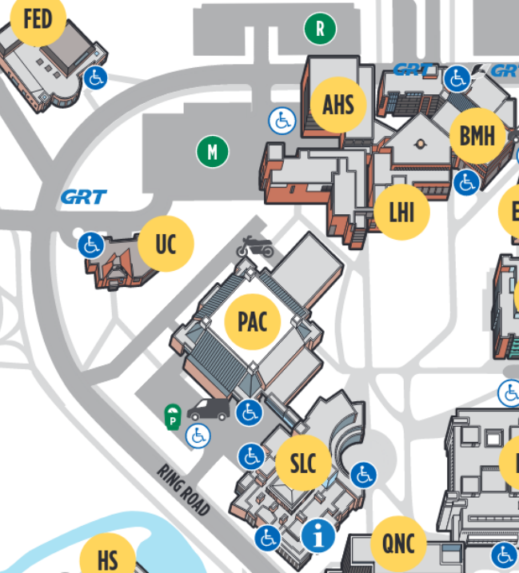
Registration and Load-In
To help speed up registration
Have your QR code and ID ready
It can be downloaded here.
YOU SHOULD BE ON TEAM ATTENDANCE LIST AND ON TEAM ROSTER
FOR LOAD IN:
Five team members must first get wristbands at the Box Office Doors
Registration and Screening: PAC Box Office Doors
This is where you will be screened and get your wrist bands for load-in
Driver will go to the PAC Load-in Door (see map)
Rest of members can walk through the building to the Load-In Area
Drivers must remain in the vehicle at all times during load in
5 members in total only for load in (1 must be an adult)
COMPETITION DAY (all members)
All members check in for screening and registration: PAC Box Office Doors
Notes:
Arti

Slide 11
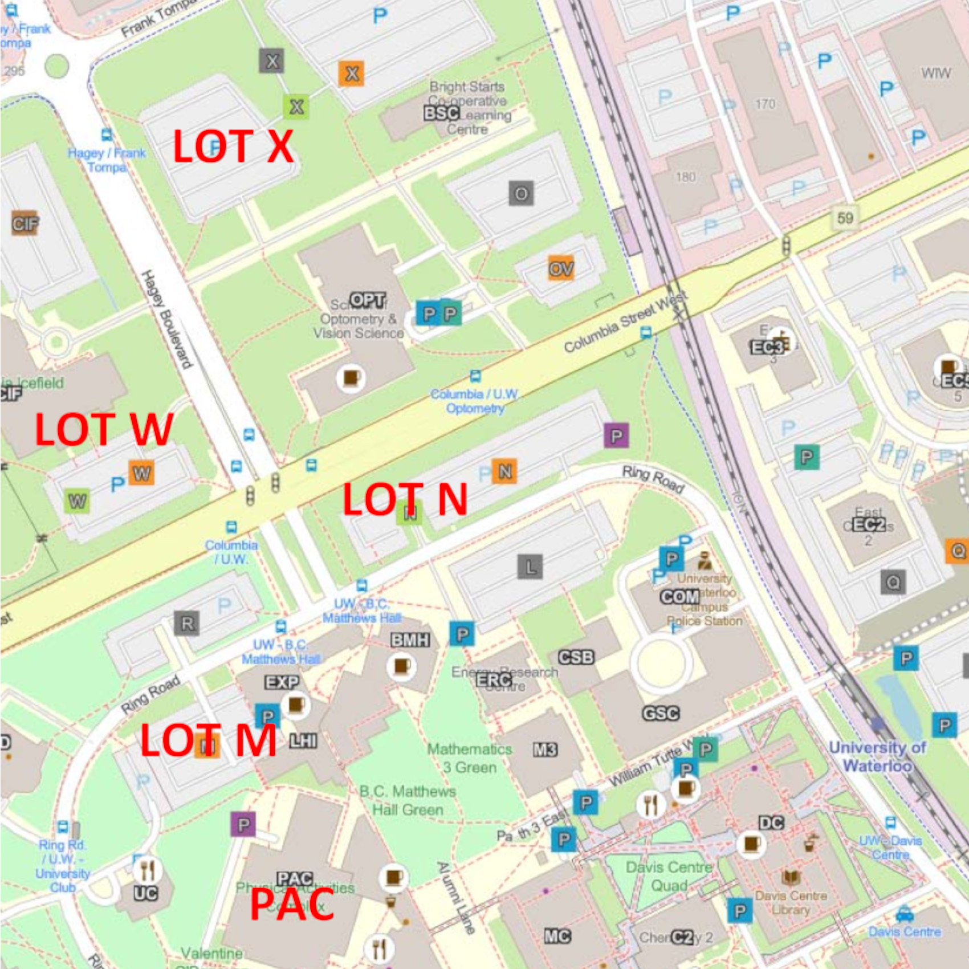
Registration and Load In
W
X
Lots X and W - free; all trucks and trailers
Lot N - Cars (paid)
Lot M - Cars (paid)
Load-in Doors
Box Office Doors
Notes:
Arti

Slide 12
Robot Field and Machine Shop
Practice Field Timings
Friday
7:15 am - 6:00 pm
6:30 pm - 8:30 pm (only teams competing on both days at this event)
Saturday
7:15 am - 6:00 pm
Machine Shop Timing:
Thu.: Load In Day: 6:30 pm - 8:30 pm
Fri.: Team Competition Day 1: 7:15 am - 8:30 pm
Sat.: Team Competition Day 2: 7:15 am - 6:00 pm

Slide 13
2022 University of Waterloo Reminder Overall Schedule
Monday, March 21 PIT Interviews
Tuesday, March 22 PIT Interviews!
Wednesday, March 23 Virtual Drivers’ Meeting 6pm ET
Thursday, March 24 Load In for Teams
Friday, March 25 Load in for Friday teams (6:45 am-7:30 am) Competition Day Load in for Saturday Teams (6:30 pm - 8:30 pm) PITS close and Load out Friday teams (6:30 pm)
Saturday, March 26 Load in for Saturday teams (6:45 am-7:30 am) Competition Day Pit close and Load Out (6:30 pm)

Slide 14
Team Spaces
Lunch Area designated for Teams: Balcony above bleachers
Quiet Room - 1005
Reminders!
No eating in pits/competition areas
No buffet/warmers/crockpots in team eating spaces or anywhere in venue
Please respect the space
Demonstrate our Gracious Professionalism to our host venue
Join the Ontario Team Support Slack group!

Slide 15
Thank you!
Looking forward to seeing you in Waterloo!
University of Waterloo Event
March 25 - Mar 26, 2022

